Slide 1
Machine Learning-Based DNA Methylation Score for Fetal Exposure to Maternal Smoking: Development and Validation in Samples Collected from Adolescents and Adults
Reporter: Je-Wei Chuang

Slide 2
Outline
Introduction
Methods
Results

Slide 3
Introduction
Methods
Results

Slide 4
Introduction
Fetal exposure to maternal smoking
Data preprocessing
Model selection

Slide 5
Introduction
Methods
Results

Slide 6
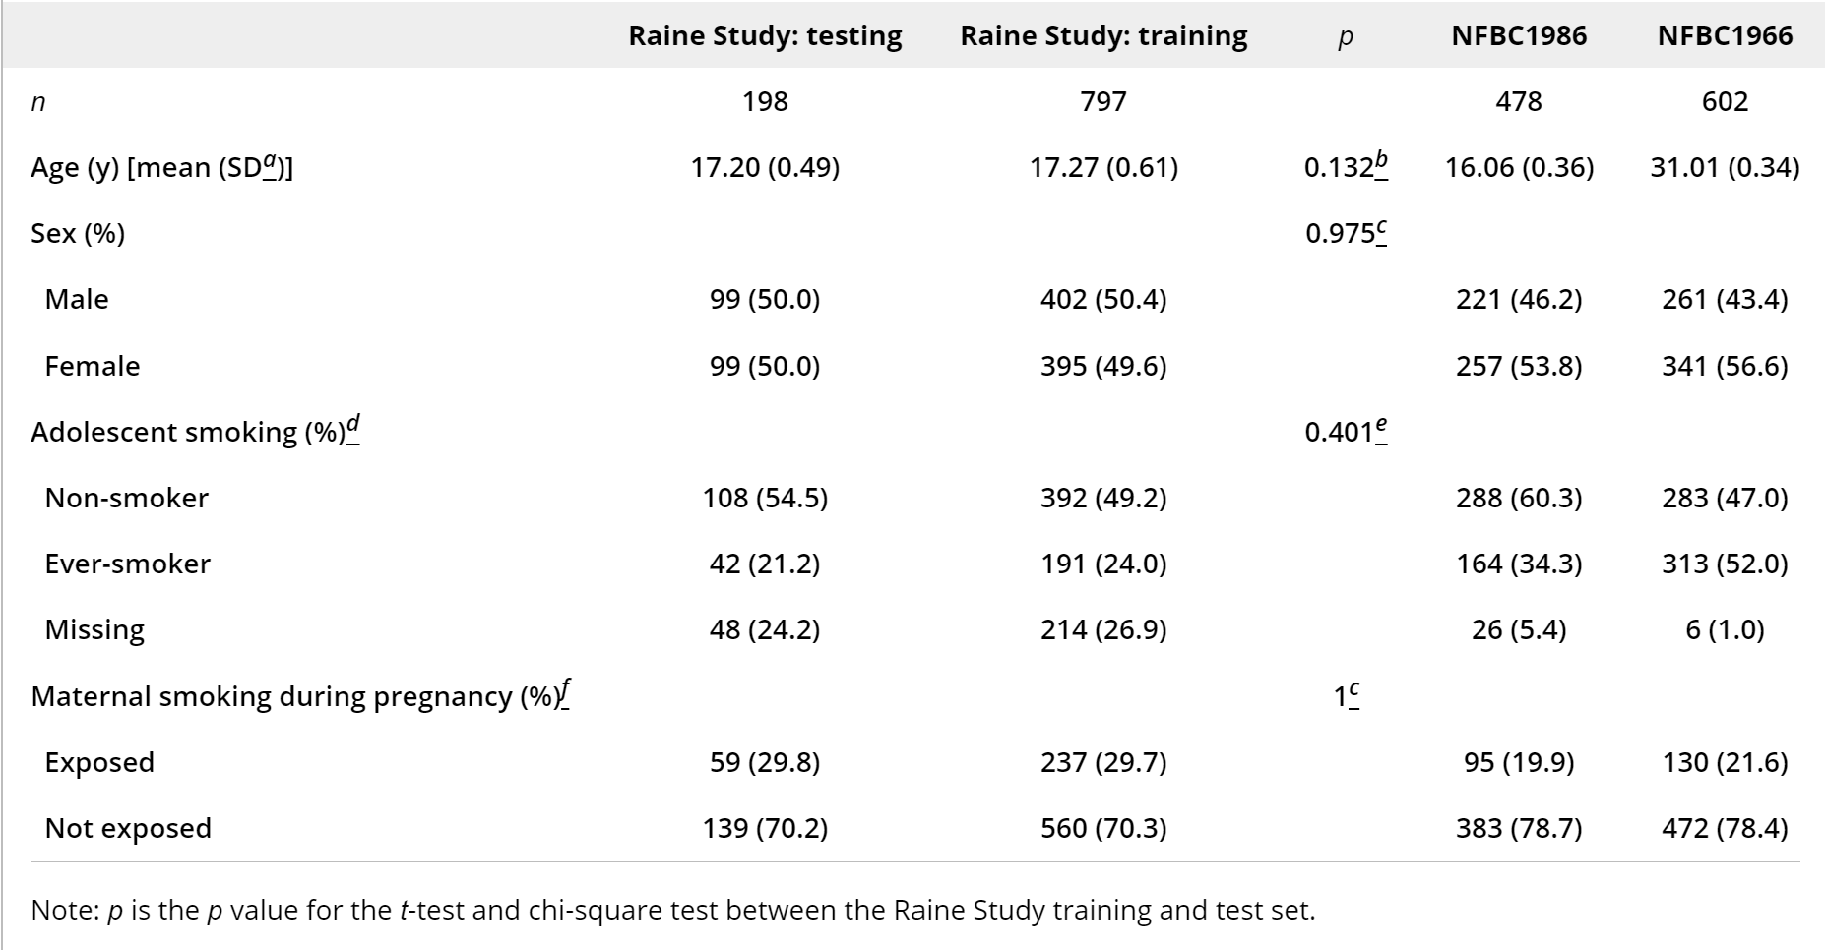
Data Sets

Slide 7
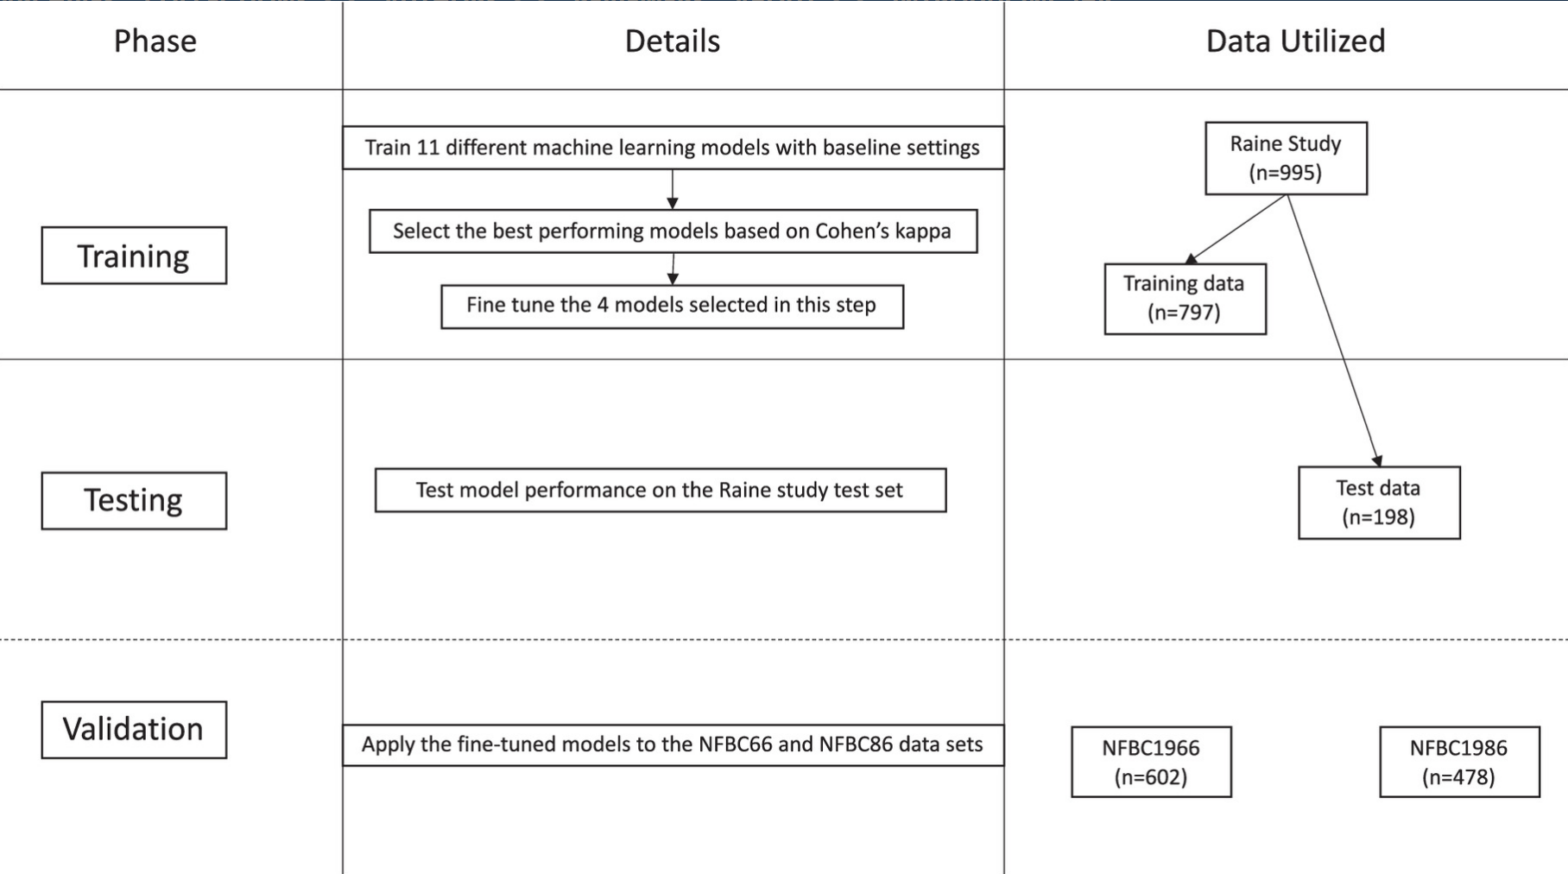
Data Sets

Slide 8
Data Preprocessing
Data selection
P-value
Significant difference
Bonferroni correction
Imbalance data
Synthetic minority oversampling technique

Slide 9
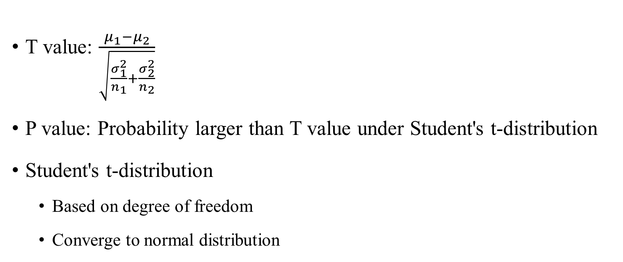
Selection
T value: $\frac{μ_{1}−μ_{2}}{\sqrt{\frac{σ_{1}^{2}}{n_{1}}+\frac{σ_{2}^{2}}{n_{2}}}}$
P value: Probability larger than T value under Student's t-distribution
Student's t-distribution
Based on degree of freedom
Converge to normal distribution

Slide 10
Selection
Smaller p-value means larger difference
Threshold for significant difference
Pick CpGs with significant difference

Slide 11
Selection
Bonferroni correction
Control false alarm (including too much sites)
Divide threshold by total number of sites
Larger miss
Use a p-value threshold between to strike balance

Slide 12
Imbalance Data
SMOTE
Create artificial data rather than simply resample
Make the cost of making mistake in minority higher
Find neighbors
Random select
Interpolation

Slide 13
Models
Gradient boosting machine
Elastic net regression
Random forest
SVM
Linear discriminant analysis
K-nearest neighbor

Slide 14
Linear discriminant analysis
TBD

Slide 15
KNN
Find k nearest neighbor
Classify by voting

Slide 16
Introduction
Methods
Results

Slide 17
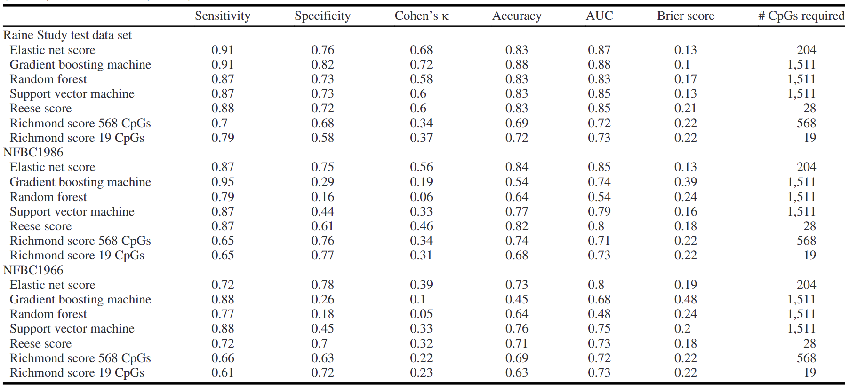
Result

Slide 18
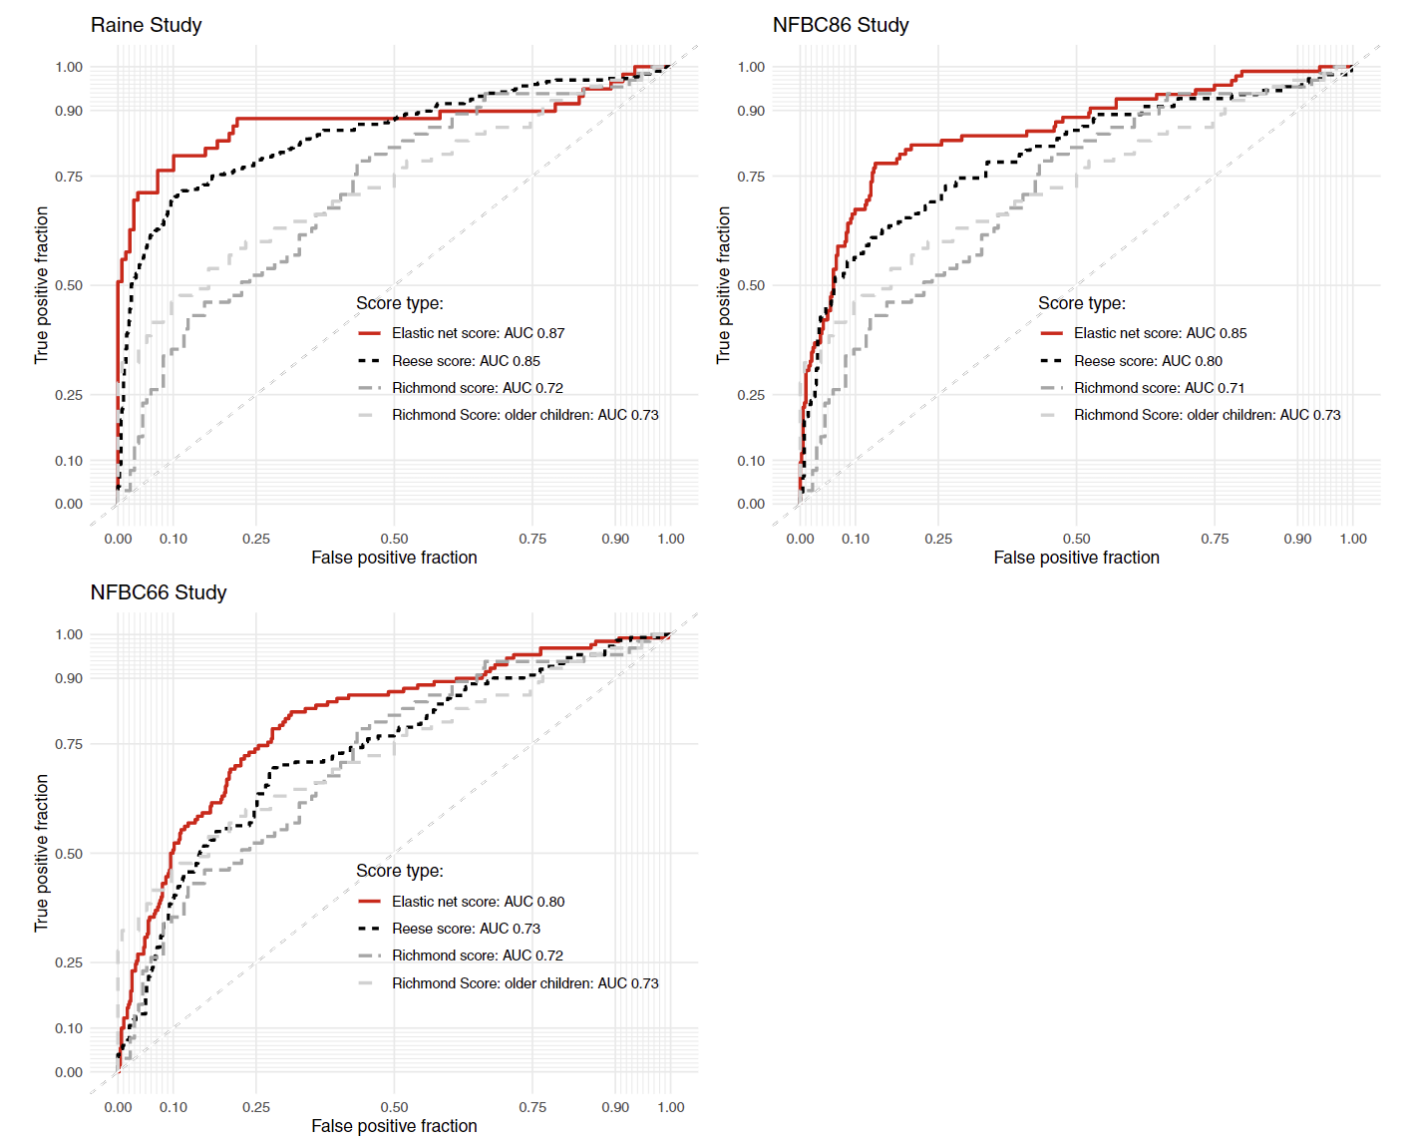
Result

